Slide 1
SuMMARIZZING

Slide 2
CONTENTS
Multi Layered Perceptron
N gram models
Sentiment analysis
Vector Semantics and Word Embeddings
RNN
LSTM
Encoder – Decoder
Attention
Transformers

Slide 3
MULTI-LAYER PERCEPTRON
A Multi-Layer Perceptron (MLP) is a type of artificial neural network that consists of multiple layers of interconnected neurons. It is a fundamental architecture used in deep learning and is considered a feedforward neural network, meaning the data flows in one direction, from input to output. Each layer in the MLP consists of one or more neurons (also known as nodes or units), and each neuron is connected to every neuron in the subsequent and preceding layers.

Slide 4
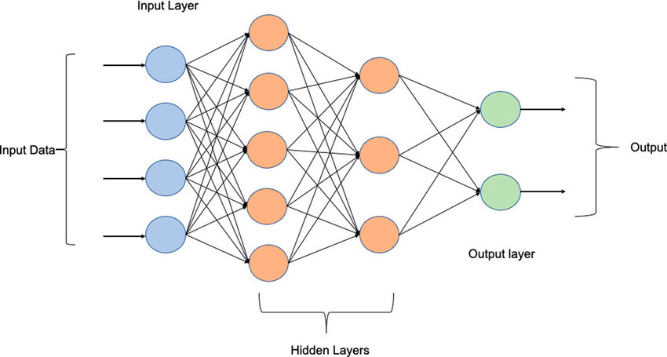
LAYERS IN AN MLP
Input Layer: The first layer of the MLP that receives the input data. The number of neurons in this layer depends on the number of features in the input data.
Hidden Layers: The layers between the input and output layers are referred to as hidden layers. Each hidden layer consists of multiple neurons, and the number of hidden layers and neurons in each hidden layer can be adjusted based on the complexity of the problem.
Output Layer: The final layer of the MLP that produces the output based on the learned representations from the hidden layers. The number of neurons in the output layer depends on the type of problem being solved (e.g., binary classification, multi-class classification, regression, etc.).
The neurons in an MLP are organized into nodes, and each node applies a weighted sum of its inputs, passes the result through an activation function, and produces an output. The purpose of the activation function is to introduce non-linearity into the network, enabling it to learn complex patterns and relationships in the data.

Slide 5
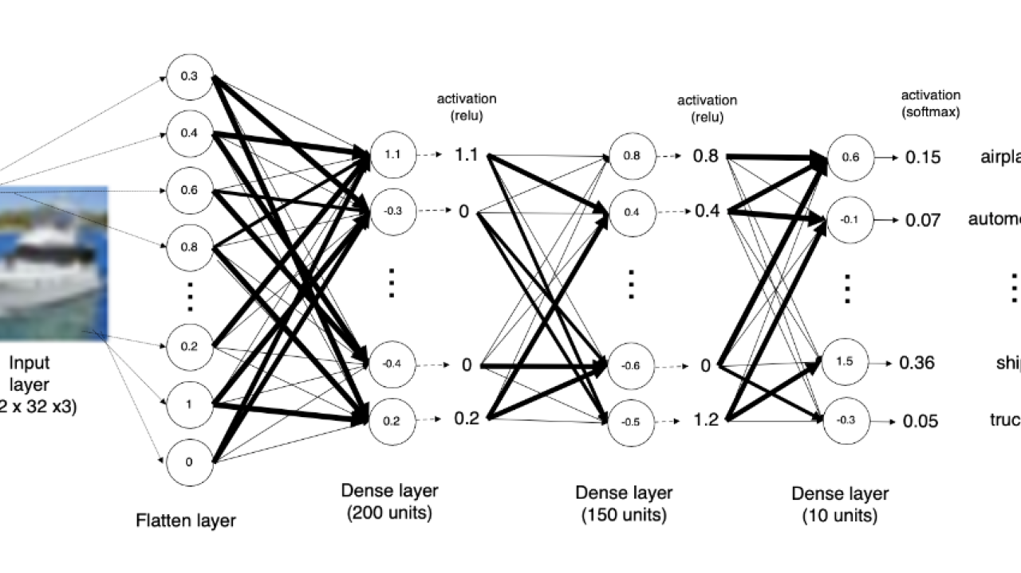
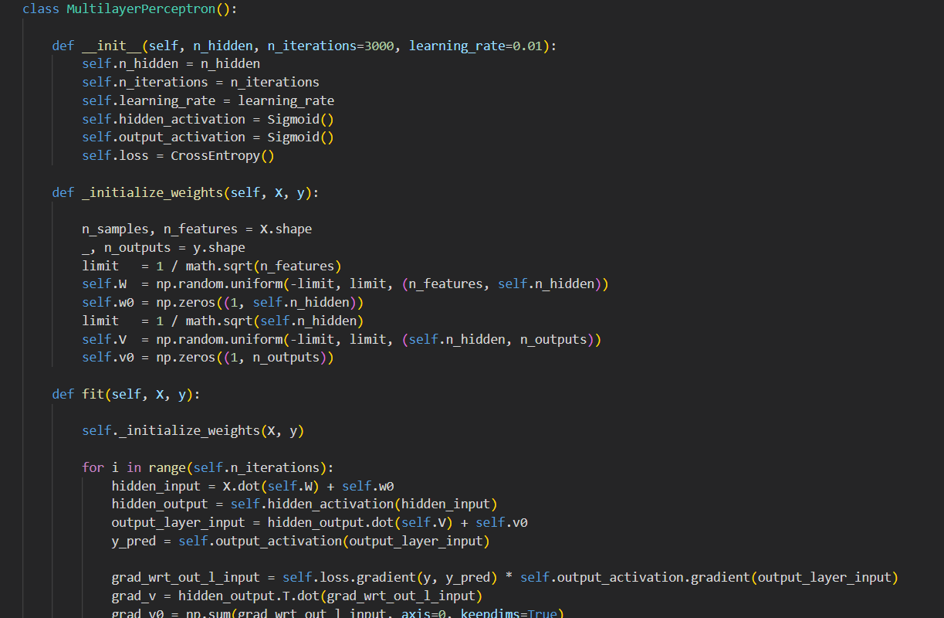
MULTI-LAYER PERCEPTRON
Training an MLP involves the use of optimization algorithms like gradient descent to adjust the weights and biases of the neurons, allowing the network to minimize the error between its predictions and the actual target values in the training data.
The activation function takes the weighted sum of the inputs to a neuron (also known as the activation or pre-activation) and transforms it into the output of the neuron (also known as the post-activation or activation). The output is then passed on to the next layer of the network. Eg: Softmax , Sigmoid
MLPs have been successfully applied to a wide range of machine learning tasks, such as image recognition, natural language processing, speech recognition, and many other complex tasks.

Slide 6
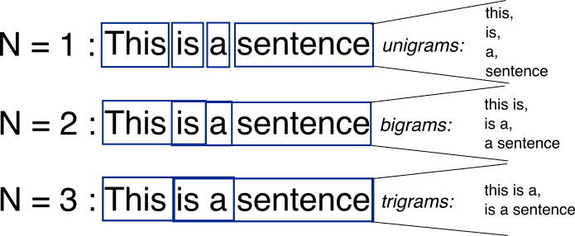
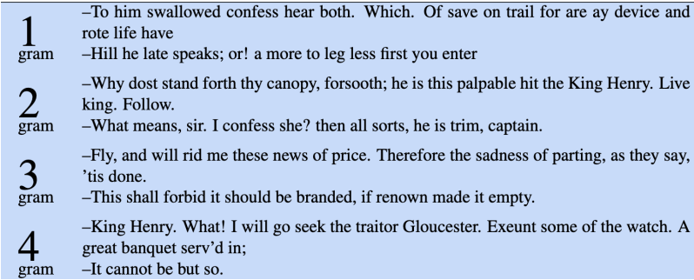
N-GRAM MODELS
N-gram models are a type of probabilistic language model used in natural language processing (NLP) and text analysis. The "N" in N-gram refers to the number of consecutive words (or characters) considered as a unit while modeling the language. N-grams are used to capture the probability of a sequence of words occurring together in a given language. Eg: Unigram(words treated independently) , Bigrams(where the model estimates the probability of a word given it's previous word) and so on

Slide 7
Markov property
N-gram models are based on the assumption of the Markov property, which states that the probability of a word in a sequence depends only on the previous (N-1) words. This assumption allows the model to estimate the probability of a word sequence based on the observed frequencies of N-grams in the training data.
To build an N-gram language model, you calculate the probabilities of different N-grams based on their occurrences in a large corpus of text (e.g., a collection of books or articles). The probabilities are then used to predict the likelihood of a specific word or word sequence in a given sentence or text.

Slide 8
METHODS USED WHILE BUILDING N-gram models
Smoothing: To deal with words that are in our vocabulary , but appear in the test set with unseen history (context).All the counts that were used to be zero, will now have a count of 1.
Backoff: Backoff is a probabilistic smoothing technique that allows the N-gram model to "fallback" to lower-order N-grams when the probability of a higher-order N-gram is zero or very low.
Interpolation: In the context of language modeling and N-gram models, "interpolation" is a technique used to combine the probabilities of different N-grams (unigrams, bigrams, trigrams, etc.) to estimate the probability of a given word sequence.
Knese-Ney Smoothing: The main idea behind this to redistribute the probability mass from seen N-grams to unseen N-grams in a way that preserves the distribution of lower-order N-grams. This means that the smoothing method effectively estimates the probability of an N-gram based on the probabilities of its (N-1)-grams.

Slide 9
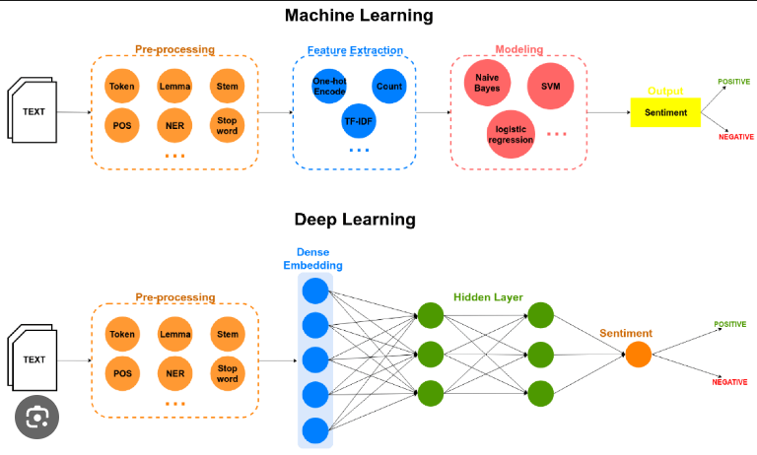
SENTIMENT ANALYSIS
Sentiment analysis is a natural language processing (NLP) technique used to determine the sentiment or emotional tone expressed in a piece of text. The goal of sentiment analysis is to classify the text as having a positive, negative, or neutral sentiment based on the emotions, opinions, or attitudes expressed by the author.
Sentiment analysis, also called opinion mining , can be done in a lot of ways. Popular methods involve Logistic Regression or using SVM models or using Naïve Bayes.

Slide 10
MEthods of sentiment analysis
Logistic Regression: Logistic regression is a type of binary classification algorithm that models the probability of an instance belonging to a certain class (in this case, positive sentiment) based on its features (words or n-grams in the text). The output of logistic regression is a probability score between 0 and 1, and a threshold is used to convert this score into a binary sentiment prediction (e.g., 0 for negative sentiment and 1 for positive sentiment).
Support Vector Machine(SVM): Support Vector Machine (SVM) is a powerful supervised machine learning algorithm used for both classification and regression tasks. It works by finding the optimal hyperplane that best divides the data into these classes while maximizing the margin between the two classes.

Slide 11
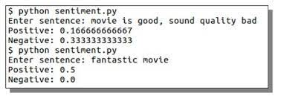
METHODS OF SENTIMENT ANALYSIS
Naïve Bayes: Naive Bayes is a probabilistic machine learning algorithm commonly used for classification tasks, particularly in natural language processing (NLP) and text classification problems. It is based on Bayes' theorem, which describes the probability of a hypothesis given the evidence or data.
The term "naive" in Naive Bayes refers to the assumption that features (attributes) are conditionally independent of each other given the class label. This means that the presence or absence of a particular feature does not depend on the presence or absence of other features, which is often an oversimplified assumption but can still work well in practice for certain types of data.

Slide 12
Vector Semantics and Embeddings
When we want train our model on words , we first need to represent them through numbers in order to feed them to the model and make prediction or generate text.
This task can be achieved using the concept of Vector semantics and embeddings.
Words that are similar in context are grouped together.
Term frequency(tf) refers to the frequency of a word in a document and Inverse Document Frequency(idf) assigns higher weights to words that occur only in few documents. Such words are quite useful for discriminating those documents from the rest of the collection.
The term context matrix formed using tf-idf word vector is used for training our model but these matrices are long and sparse so we use another dense vector embedding method like the word2vec method where the model learns one foxed embedding for each word.

Slide 13
Methods to include context in word embeddings
Continuous bag of words – In this method a word is predicted based on a fixed number of context words before and after the target word. As order doesn't matter in this method , hence the name "bag of words".
Skip gram – In this method , given a sequence of words in a fixed window size , a word is predicted based on negative sampling on the dataset or vocabulary and the model is trained so as to differentiate between these cases. The middle word is used to predict the surrounding words.

Slide 14
Skip gram model with negative sampling
We treat the target word and neighbouring context words as positive sample , then sample other words in lexicon to get negative samples and then train the model to distinguish between these cases .
The model learns two vectors for each word , one as a target word and the other as a context word.
Words are randomly assigned vectors at the beginning and then slowly shift so as to get similar context words in nearby hyperspace based on cross entropy loss functions and gradient descent.

Slide 15
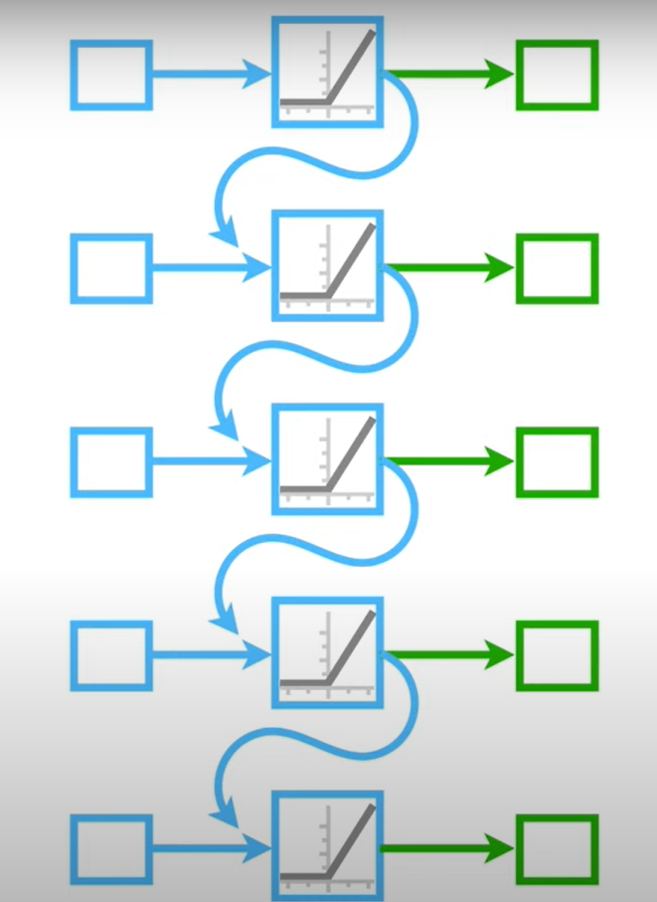
Recurrent Neural networks
This is one of the basic neural network model for NLP.
Recurrent Neural Network(RNN) is a type of Neural Network where the output from the previous step is fed as input to the current step. In traditional neural networks, all the inputs and outputs are independent of each other, but in cases when it is required to predict the next word of a sentence, the previous words are required and hence there is a need to remember the previous words .
The main and most important feature of RNN is its Hidden state, which remembers some information about a sequence. The state is also referred to as Memory State since it remembers the previous input to the network. It uses the same parameters for each input as it performs the same task on all the inputs or hidden layers to produce the output. This reduces the complexity of parameters, unlike other neural networks.

Slide 16
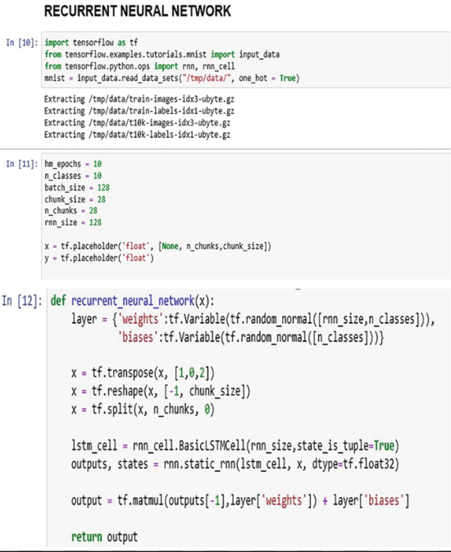
Implementation of rnn
In RNN the input is taken , then after using a particular weight and bias and passing through an activation function like tanh or ReLU we obtain the hidden state at a time t.
This hidden state is then again used for calculating the next hidden state for iteration t+1 . This is forward pass in RNN.
In this way the same weights and bias are used to train the model and then optimized using backpropagation through time and loss functions to get more accurate predictions.
This is backward pass in RNN.

Slide 17
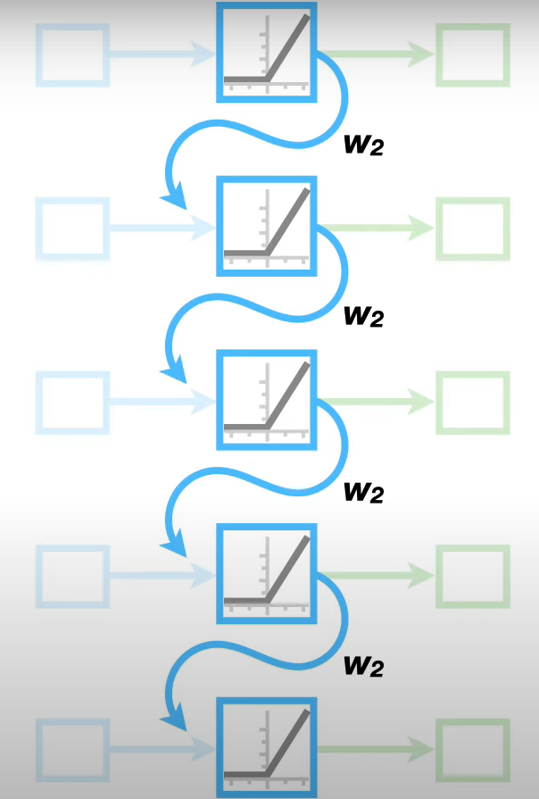
Limitations of Recurrent Neural networks
Even though RNN is one of the fundamental neural network for NLP purpose , but still it has some limitations .
Vanishing Gradient problem - When the value of w2 very small , over time due to recurrent nature of RNN , the input for the next cycle becomes very less and so does the gradient used for gradient descent . As a result during optimization process the velocity with which the model reaches the lowest loss state is exponentially low.
This leads to increased time for optimization.
Exploding Gradient problem – Contrary to the above problem , exploding gradient problem is caused due to large values of w2 . Over repeated cycles , the value of the hidden state keeps on increasing and so does the gradient , as a result of which during optimization , the model overshoots the minimum loss state and hence there is inefficient optimization.

Slide 18
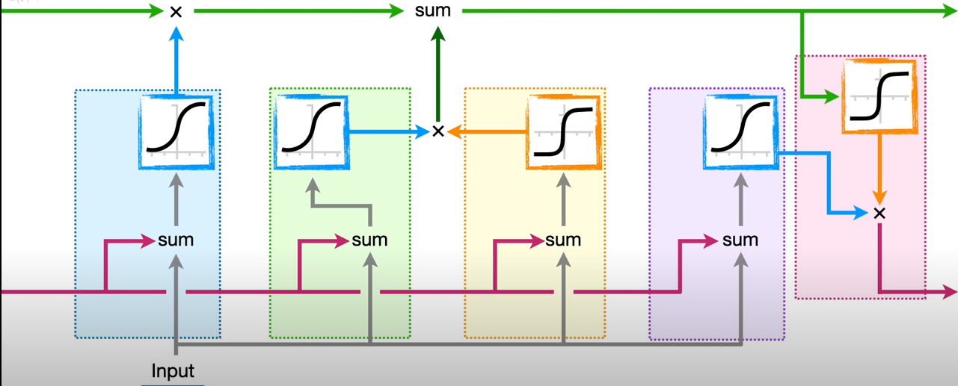
Long short – term memory neural network
While RNN is good for making short term predictions over small number of cycles , it gives incorrect predictions over longer cycles due to the previously mentioned problems as a result RNN's are not good for utilizing large amount of old data to make new predictions.
This problem of RNN is solved by one of its variant LSTM. LSTM are helpful in generating more contextual long texts.
In LSTM The input gate controls what information is added to the memory cell. The forget gate controls what information is removed from the memory cell. And the output gate controls what information is output from the memory cell. This allows LSTM networks to selectively retain or discard information as it flows through the network, which allows them to learn long-term dependencies.

Slide 19
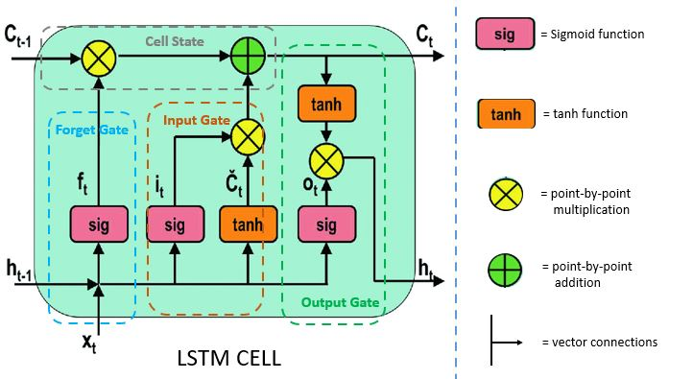
Structure of lstm
1. Forget Gate: The information that is no longer useful in the cell state is removed with the forget gate. Two inputs x_t (input at the particular time) and h_t-1 (previous cell output) are fed to the gate and multiplied with weight matrices followed by the addition of bias. The resultant is passed through an activation function which gives a binary output.
2. Input gate: The addition of useful information to the cell state is done by the input gate. First, the information is regulated using the sigmoid function and filter the values to be remembered similar to the forget gate using inputs h_t-1 and x_t. Then, a vector is created using tanh function that gives an output from -1 to +1, which contains all the possible values from h_t-1 and x_t. At last, the values of the vector and the regulated values are multiplied to obtain the useful information.
3. Output gate: The task of extracting useful information from the current cell state to be presented as output is done by the output gate. First, a vector is generated by applying tanh function on the cell. Then, the information is regulated using the sigmoid function and filter by the values to be remembered using inputs h_t-1 and x_t. At last, the values of the vector and the regulated values are multiplied to be sent as an output and input to the next cell.

Slide 20
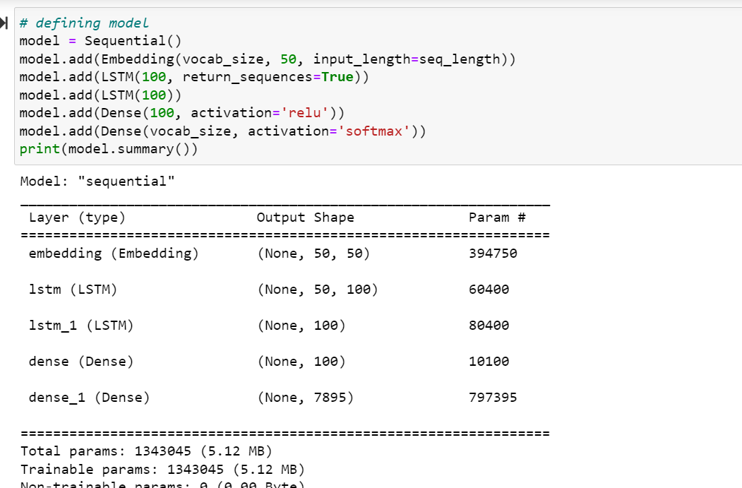
IMplementation of lstm
In the task for generating comedy lines , LSTM's were a good way to implement it as we had to deal with a large dataset of over 1,25,000 words and generate longer contextual texts.
One way to train our model was to use a fixed number of tokens as sequence which would be used as an input to predict the next word thus our model became capable of learning long-term dependencies in sequential data.

Slide 21
ENCODER-DECODER ARCHITECTURE
An Encoder-Decoder Architecture aims to map a fixed-length input with a fixed-length output where the length of the input and output may differ. Encoder-decoder networks have been applied to a very wide range of applications including summarization, question answering, and dialogue, but they are particularly popular for machine translation. Fundamental to this architecture is the encoder's role in creating a contextualized representation (context) of the input sequence, which is subsequently passed to the decoder to generate task-specific outputs.

Slide 22
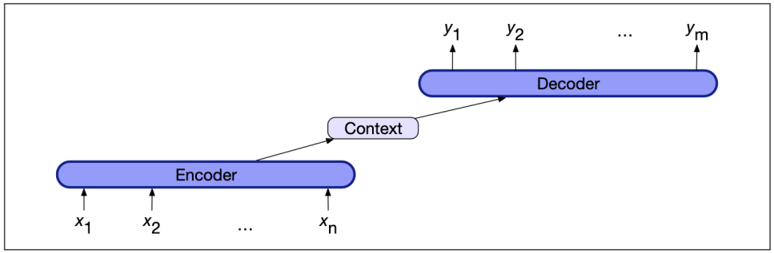
COMPONENTS

Slide 23
COMPONENTS AND WHAT THEY DO
ENCODER: A stack of several recurrent units (LSTM or GRU cells for better performance) where each accepts a single element of the input sequence, collects information for that element and propagates it forward.
ENCODER VECTOR: This is the final hidden state produced from the encoder part of the model. It is the initial hidden state of decoder part of the model.
DECODER: A stack of several recurrent units where each predicts an output y_t at a time step t. Softmax is used to create a probability vector which will help us determine the final output.

Slide 24
ATTENTION

Slide 30
THANK YOU

